Slide 1
Illini Datathon
Ichiro Tai, Billy Li, Zixiong Feng, Deepak Katariya

Slide 2
What We Have Done

Slide 3
Outline
Predicting stock prices is hard because
physical factors vs. physiological
rational and irrational behavior
We opted to normalize our data with Dow Jones Industry Average
Used Sentiment Analysis, Linear regression and other techniques to come up with an estimate of stocks
Came up with a business plan based on the data we analyzed and predictions

Slide 4
Normalize
Smooth
Linear Regression
With Dow Jones Industrial Average (DJIA)
Moving average
“Unnormalize”
With our prediction on DJIA based on our Google Trend keyword correlation model
Fitting multi-degree regression model on normalized smoothed stock prices
Historical Stock Price
Predicted Stock Price

Slide 5

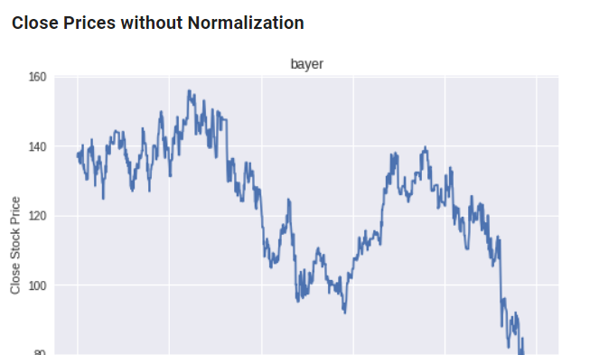
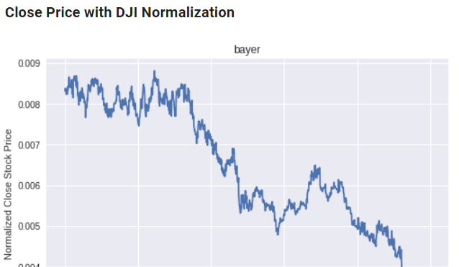
Normalising the Data
Dow Jones Industrial Average was used to normalize our data
“Dow jones is a stock market index that indicates the value of 30 large, publicly owned companies based in the United States and how they have traded in the stock market during various periods of time”
By dividing all stock prices by the present DJIA, this helped us eliminate noises that are not directly related to the stock performance
E.g. inflation, market performance, government policies, etc.

Slide 6
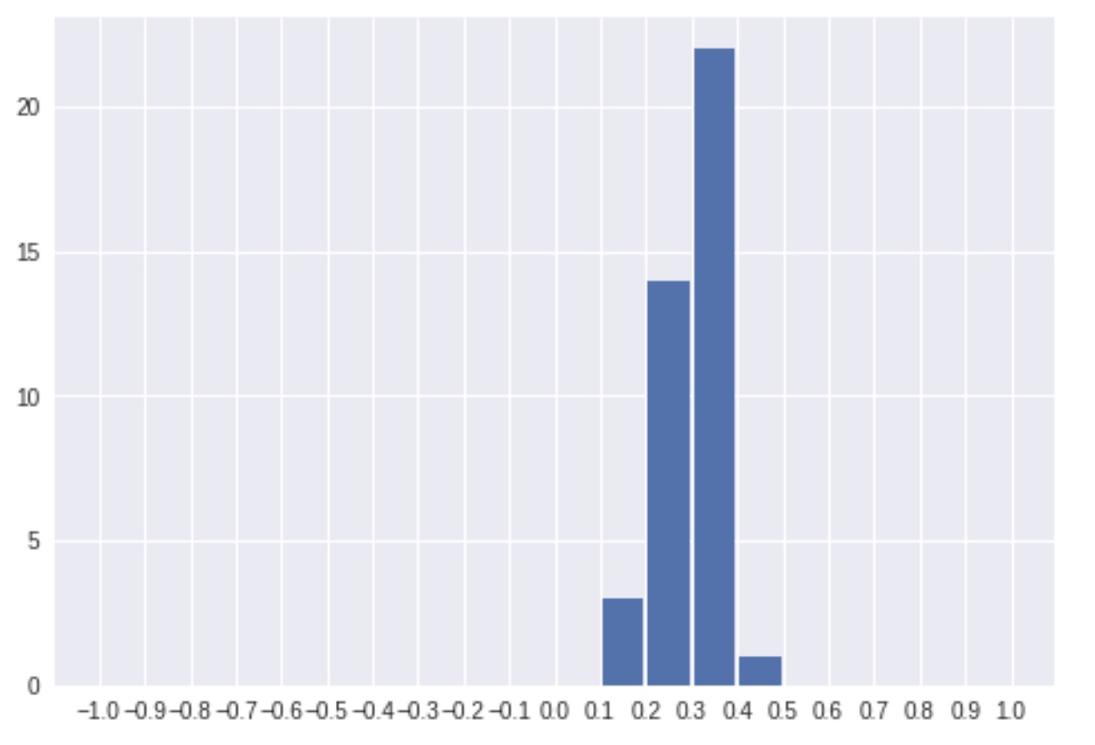
Sentiment Analysis (NOT TAKEN)
We experimented a round of sentiment analysis on the earnings call transcripts
Performed on sentence-level and combined as an average
Python, NLTK SentimentIntensityAnalyzer
Result
Anticipated range: [-1, 1]
Actual range: [0.152, 0.427] with mean of 0.298
These transcripts are relatively neutral in tones, making it almost impossible to differentiate based on sentiments
Our conclusion
Sentiment analysis is unhelpful as it provides no additional values to the model

Slide 7
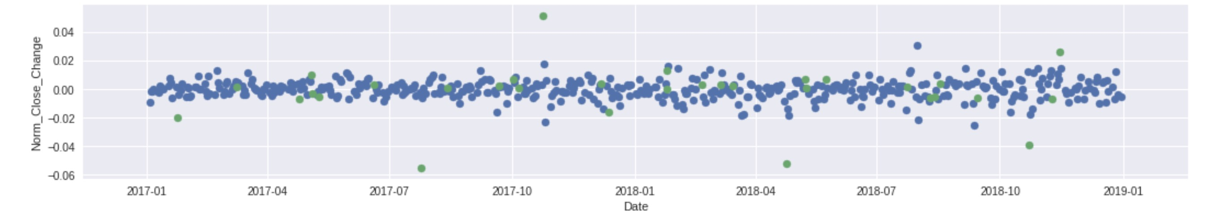
8-K Report Analysis
The graph below marks dates which a 8-K report was published with green dots. There is a strong suggestion that certain reports can cause large short-term fluctuations in the daily stock price; In our model we identified these points of interest as anomalies which could be reasonably omitted during data cleaning to create a more generalized model.
Percentage change in stock price per day (3M)
2017 Q3 report
New 5-year financial Objectives
2016 Q4 report
2017 Q2 report
2018 Q1 report
2018 Q3 report

Slide 8
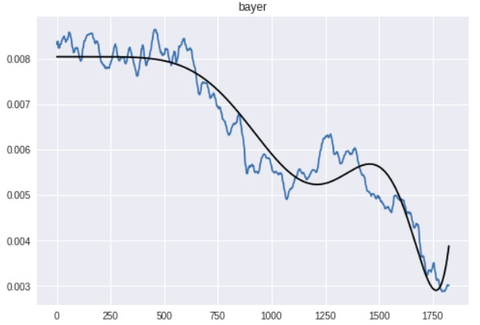
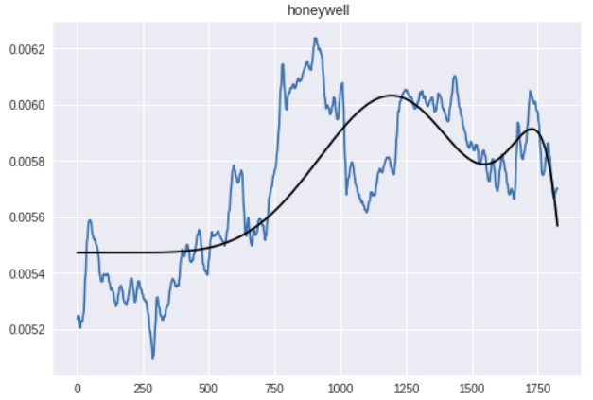
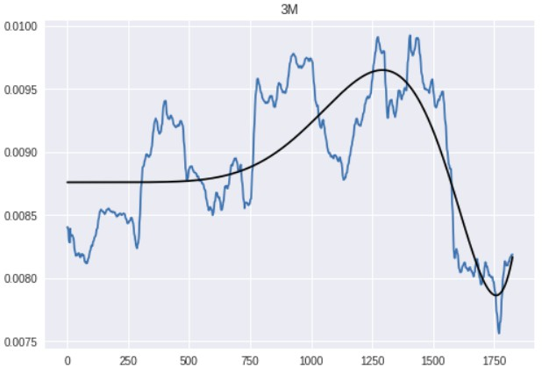
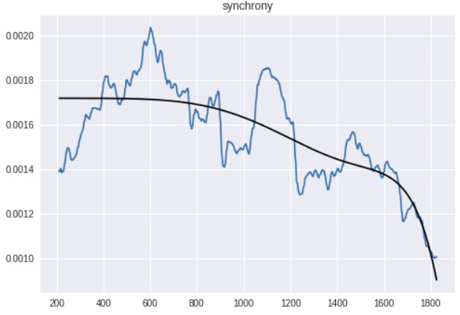
Smoothing & Linear Regression
To further eliminate market noise, a moving average of window 10 is applied on each company’s stock prices
Same regression model is applied on the smoothed, normalized stock prices of 4 companies

Slide 9
“Unnormalize” with Predicted DJIA
To “unnormalize” our predictions on the stock price, we must also predict the DJIA.
Key idea: natural market momentum exhibited in market index like DJIA
DJIA is relatively stable as it represents an entire market
Social reaction could largely reveal its trend
In our case, we use Google Trend keywords to find correlation

Slide 10
DJIA Prediction
Calculate the correlation between growth rate of DJIA and search frequency of certain rather obscure finance-related keywords on Google Trends
Change in search frequency seldom has a large immediate effect on Dow Jones; it takes a period of time for the predicted change to take effect
Idea from: https://www.ncbi.nlm.nih.gov/pmc/articles/PMC3635219/

Slide 11
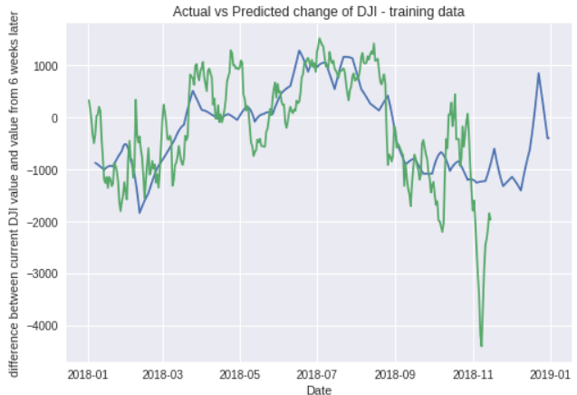

DJIA Prediction - Results
A quadratic regression model is used
Search frequency of keywords vs. percent change between current DJIA and 6-week-from-now DJIA
3 chosen keywords: “metals, hedge, nasdaq”
$R^{2}$ of our model: 0.536
Regression model
Actual

Slide 12
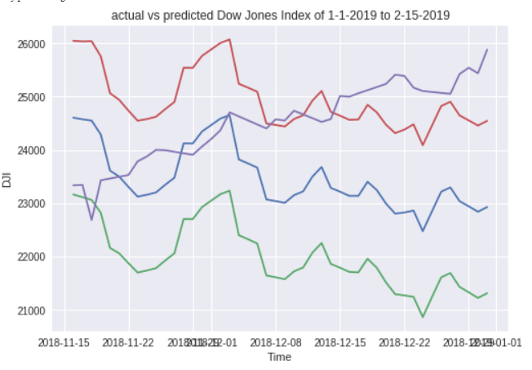
DJIA Prediction - Results
Actual Dow Jones index remains in our 95% confidence interval for 1 month.
Actual DJI
Upper 95% CI
Predicted DJI
Lower 95% CI
January 29th

Slide 13
Our Final Results

Slide 14
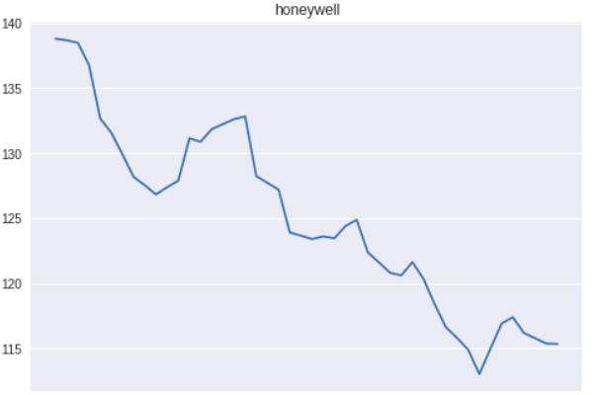
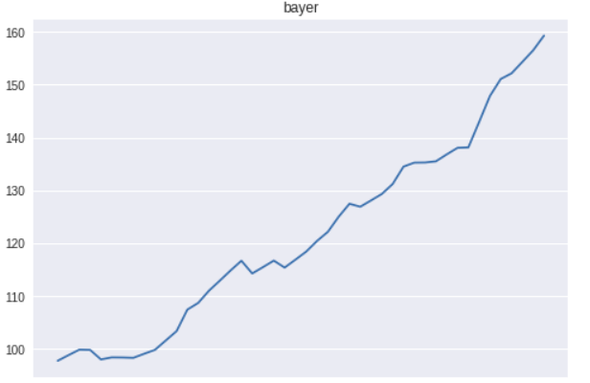
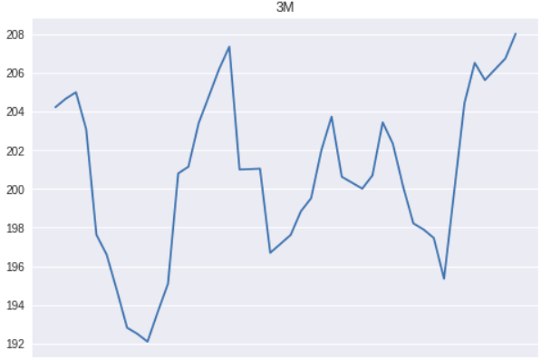
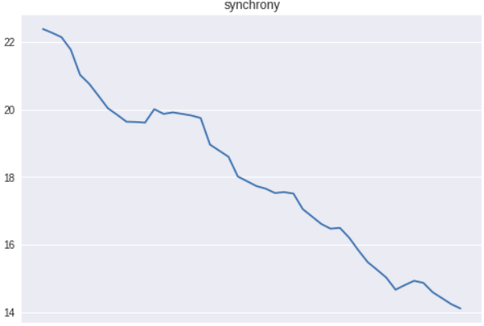
Final Prediction

Slide 15
Business Thesis
Investment should be made not to the stock with the highest magnitude but with the highest growth rate
Based on our model, Bayer has the highest growth rate, so our money is bet on Bayer
Company | Stock Growth Rate
Bayer | 62.85%
Honeywell | -16.90%
3M | 1.86%
Synchrony | -36.99%

